Slide 1


25Credit
9872 4908 2345 9898
VALID TILL 04/19
Team: NAÏVE BAE-S

Slide 2
Contents
1
Introduction
2
Exploratory Data Analysis
3
Data Pre-Processing
4
Business Solution
5
Model Selection
6
Recommendations
7
Conclusion

Slide 3
Introduction
1
Introduction
2
Exploratory Data Analysis
3
Data Pre-Processing
4
Business Solution
5
Model Selection
6
Recommendations
7
Conclusion

Slide 4
Credit Card Fraud Detection
Definition of Credit Card Fraud
Credit card is stolen or lost, or its information (credit card no or pin) is used to make unauthorized transaction. Also includes:
Theft fraud/ counterfeit fraud
Application fraud
Behavioural fraud
Authorisation or verification fraud
Chargebacks or refund frauds
Detecting suspicious orders

Slide 5
Credit Card Fraud Detection
Conventional Solutions → Reactive Fraud Detection
Mixture of various Security Tool Detection Techniques
Address Verification Service
Card Verification Number
Payer Authentication
(3-D Secure)
Two-factor Phone Authentication
Credit History Check
Matching address with issuing bank
Verify Card Verification Code (CVV)
User Authentication
User Authentication
Background Check
Email Verification
Customer Order History
Device Fingerprinting
Black Listing
Velocity Checks
User Authentication
Background Check
Device Identification Techniques
Profiling Suspicious Customers
Detect Automated Fraud

Slide 6
Exploratory Data Analysis
1
Introduction
2
Exploratory Data Analysis
3
Data Pre-Processing
4
Business Solution
5
Model Selection
6
Recommendations
7
Conclusion

Slide 7
Summary Statistics
Duplicated Values Inspection
Missing Values Inspection
Distribution Plot Analysis
Fraud Class Analysis
Outlier Inspection
Exploratory
Data
Analysis

Slide 8
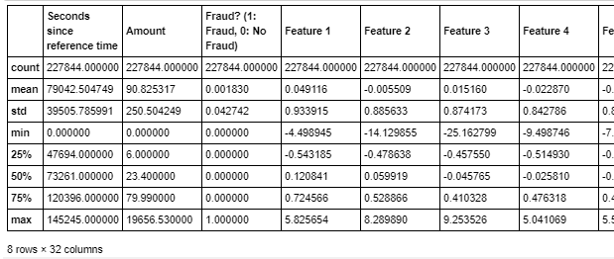
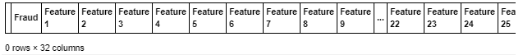
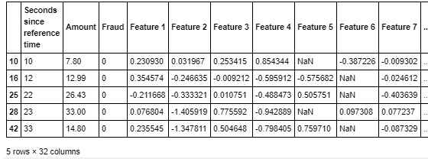
Exploratory Data Analysis
Dimensionality
227,844 instances x 32 attributes
Summary Statistics
Feature 1 to 29 are generally similar in values range (due to PCA transformation)
Seconds since Reference Time & Amount have different scale.
Duplicated Values
No duplicated Values
Missing Values
Missing Values exists in 2 columns: Features 5 & 6

Slide 9
Distribution Plot Analysis
Most features have skewed distribution or normal distribution while Feature 23 follows a uniform distribution → Need to perform feature selection to remove insignificant features

Slide 10
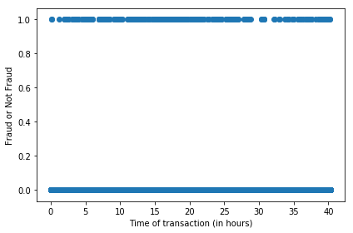
Fraud Class Analysis
Fraud Class Histogram
Scatter Plot for Fraud Class & Transaction Time
Need to conduct resampling
“Seconds Since Reference Time” bad predictor
Indication of significant imbalance between data points for class “Fraud” and “Non-Fraud”
Pattern for both non-fraudulent and fraudulent transactions seems to be random regardless of hour of the day

Slide 11
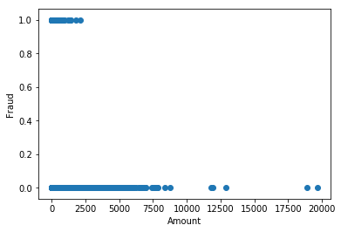
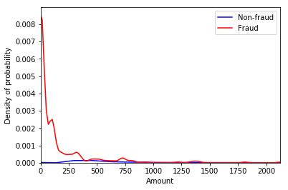
Fraud Class Analysis
Scatter Plot of Fraud Class & Transaction Amount
Line Graph for Fraud Probability
Fraudulent transactions more concentrated towards lower amount (<2500) → Unintuitive
Density of probability for fraud is much higher for lower amount & it increases as the amount lowers

Slide 12
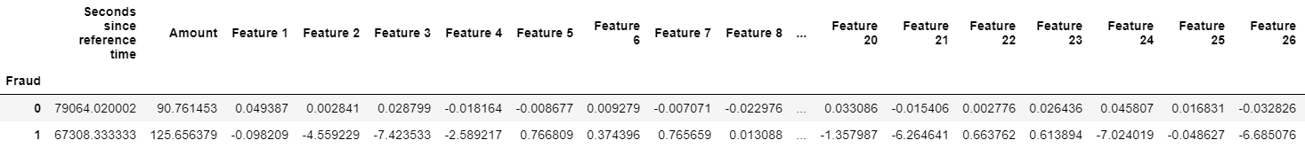
Fraud Class Analysis
Check for Features Mean Values in both Fraud and Non-Fraud Category
Feature 3 & Feature 26 are drastically different for fraud and non-fraud categories. The company can keep these Features in view for early fraud detection analysis.

Slide 13
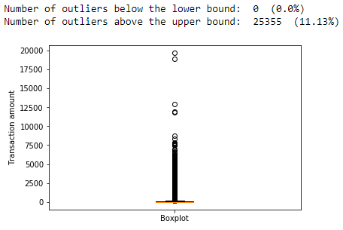
Outlier Inspection
Rationale for Keeping Outliers
-75 out of 25355 outliers are classified as frauds. 75/417 = 18% of Fraudulent cases and outliers
-Removing them from the dataset would be a bad idea due to the huge information loss for the machine learning models.

Slide 14
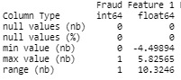
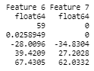
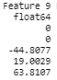
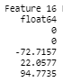
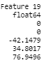
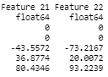
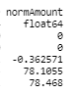
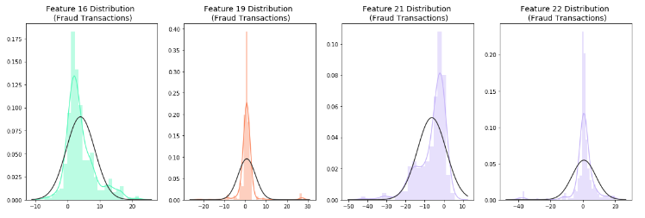
Outlier Inspection
Feature 16
Feature 19
Feature 21
Feature 22
Feature 16, 19, 21 and 22 has the most skewed range as compared to the rest

Slide 15
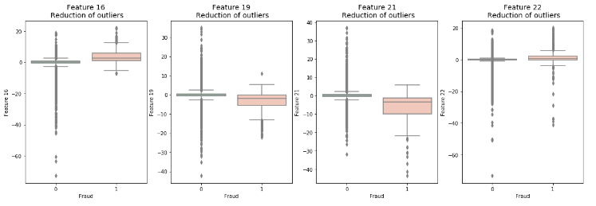
Outlier Inspection
Feature 16
Feature 19
Feature 21
Feature 22
Outliers values are present in both “Fraud” and “Non-Fraud” class labels If we remove the 75 Fraud outliers, our dataset will become more imbalanced

Slide 16
Data Pre-Processing
1
Introduction
2
Exploratory Data Analysis
3
Data Pre-Processing
4
Business Solution
5
Model Selection
6
Recommendations
7
Conclusion

Slide 17
Normalisation and Dropping Time
Missing Value Imputation
Feature Selection
Data Resampling
Splitting Dataset
Data
Pre-processing

Slide 18
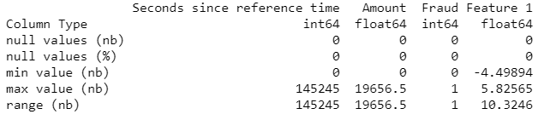
Normalization and Dropping Time
CHECK FOR ATTRIBUTE VALUES RANGE
Time
Amount
Rationale for Normalization
Dropped
Wide Range
Adds unjustified weight on the features for prediction model building
Notes:
Since the value of amount and time have a very different scale from the rest, we should consider normalising the columns "Amount" and "Seconds since reference time"

Slide 19
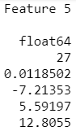
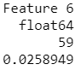
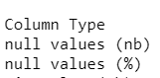
Missing Values Imputation
Check for Presence of Missing Values
Feature 5
Feature 6
- Only Feature 5 and 6 has missing values
- Percentage of missing values over whole dataset is below 3%

Slide 20
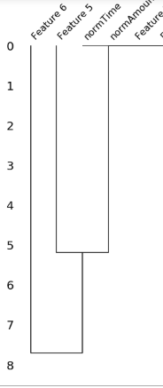
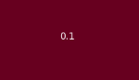
Missing Values Imputation
Nullity Correlation Matrix Heatmap + Dendrogram
F5
F6
F5
F6
Marginal correlation (0.1) between the presence or absence of Feature 5 & 6
Relationship between normAmount and the missing values for Feature 5
Relationship between missing values for Feature 5 and Feature 6
Notes:
In this case, it shows that only Feature 6 and 5 are missing and there is a 0.1 correlation between the missing values in these two columns.
Dendrogram interpretation:

Slide 21
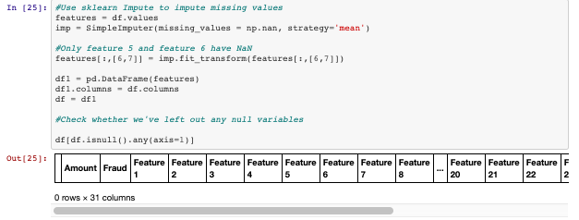
Missing Values Imputation
Data NOT Missing Completely at Random (MCAR)
Features definition and contexts are unknown
SOLUTION : MULTIPLE IMPUTATION (using sklearn by median values)
Notes:
Dropping the rows will make the model biased and we will be using Imputation instead

Slide 22

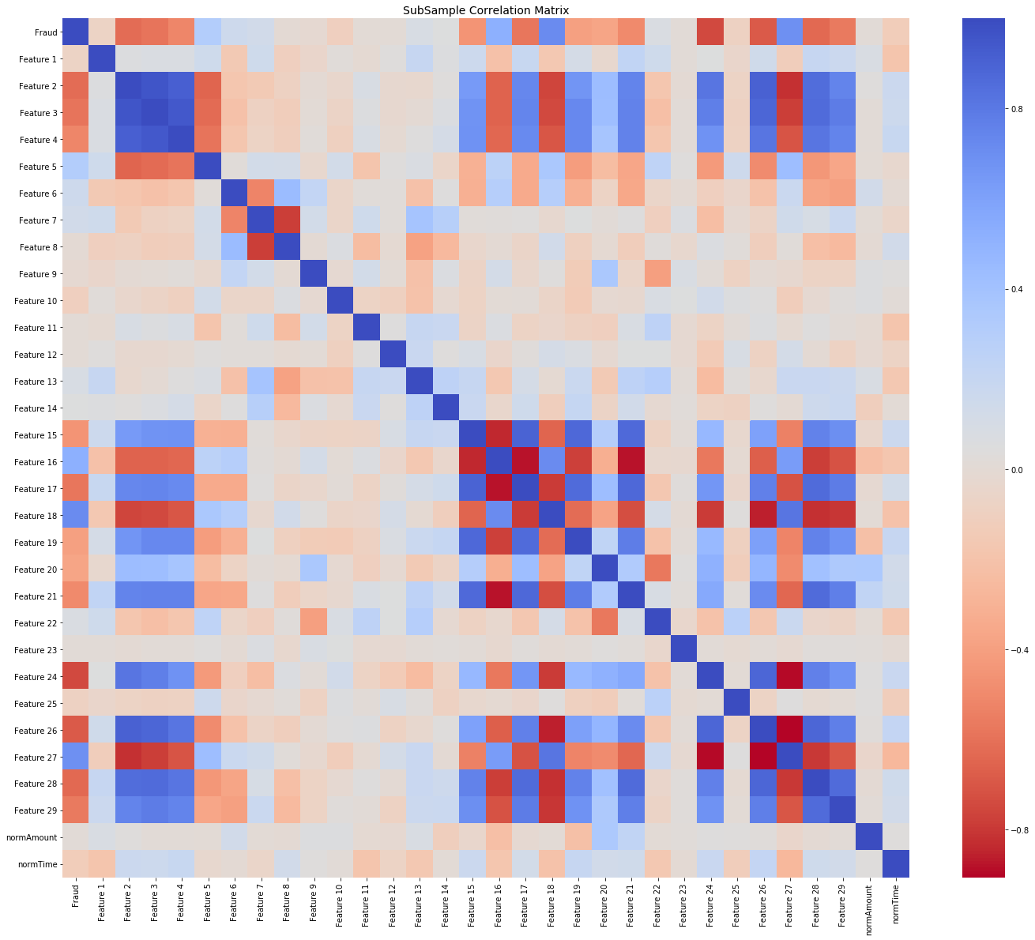
Feature Selection
Data Shuffling
Correlation Matrix
Forward Selection
Step Forward Feature Selection
Parameters
K_features: 19
forward: True
Scoring: F1 Score
Parameters
Normal Distribution
Frac: 1
Random_state: 42
Remove Features with high positive or negative correlation
[Features 7, 16, 27, 2, 21]
Selected Feature:
0, 1, 2, 4, 6, 8, 9, 10, 11, 14, 15, 17, 18, 19, 20, 21, 23
Minimize bias and patterns in the training dataset
Notes:
Data Shuffling: avoid element of bias / patterns in the split datasets (after splitting into training, testing and validation datasets) before training the ML model and subsampling → Improve ML model quality + Improve predictive performance
Correlation Metrics:
Negative Correlations: Features (7 and 8), (15 and 16), (16 and 17), (16 and 21), (24 and 27), (26 and 27) are negatively correlated.
Positive Correlations: Features (2,3, and 4), (2 and 26), (15 and 21) are positively correlated. Notice how the higher these values are, the more likely the end result will be a fraud transaction.
So now we will be removing features 7, 16, 27, 2, 21
Chose F1-score to see which is the best model and chose

Slide 23
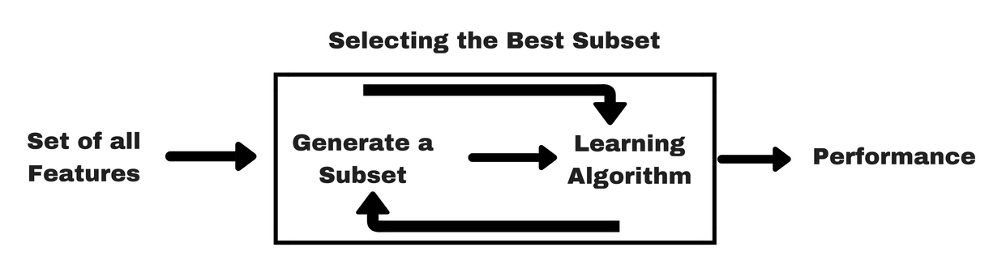
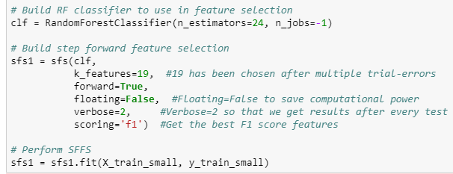
Feature Selection- Implementation
Notes:
It seems setting n_jobs=-1 does indeed just select all physical cores and maximises their usage. Have a look at the comments in this answer on StackOverflow.
Floating=False. If floating were true, then variables once excluded could be included again. Leading to more combinations
Verbose: 0 (quiet): you just get the total numbers of tests executed and the global result
1 (default): you get the same plus a dot for every successful test or a F for every failure
2 (verbose): you get the help string of every test and the result

Slide 24
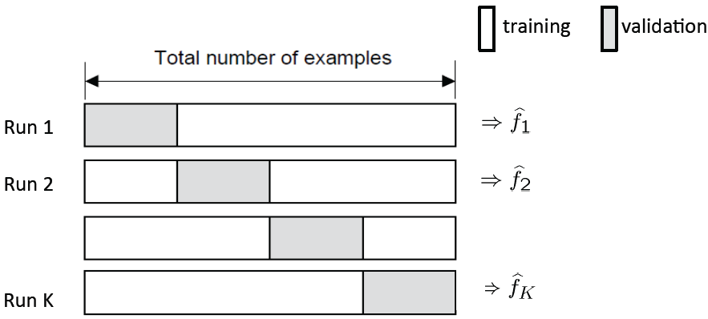
Splitting Dataset
Train Set
Test Set
80%
20%
K-fold Cross-Validation
Test Set: to be used for model evaluation metrics
Training Set: used for model training while k-fold cross validation is used for parameter tuning
Notes:
Source: https://towardsdatascience.com/train-validation-and-test-sets-72cb40cba9e7

Slide 25
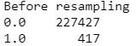
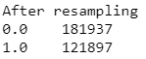
Data Resampling
Synthetic Minority Over-sampling Technique
TOMEK Links
Create synthetic data points of the minority class to increase the number of data points
Parameters
Sampling Strategy = 0.67
Kind = regular
Remove data points which have possibly been misclassified, based on distance
Parameters
Sampling Strategy = 0.67
Smote = Smote model
Notes:
t-SNE tells us if our prediction model will correctly able to cluster our training set datapoints correctly. From the plot above, we can see that the data can be classified into fraud and non-fraud and thus, we will be moving forward with it N_component = 2 because 2 classes., Random_state=42 so it's easy to re-run and test
SMOTE: it creates synthetic (not duplicate/replicate) samples of the minority class. Hence making the minority class equal to the majority class. SMOTE does this by selecting similar records and altering that record one column at a time by a random amount within the difference to the neighbouring records.
Sampling strategy is 0.67 because we want our fraud to non fraud ratio to be 2:3 to avoid creating excess data points

Slide 26
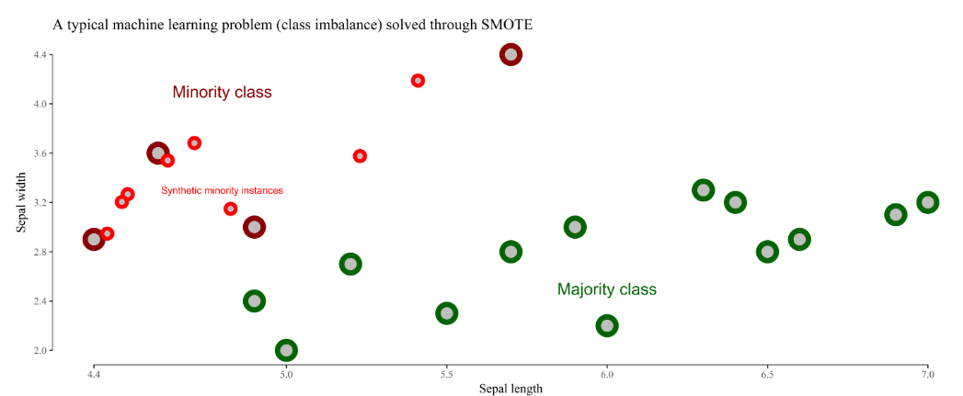
Data Resampling- SMOTE
Create artificial data points from existing data points (minority class)

Slide 27
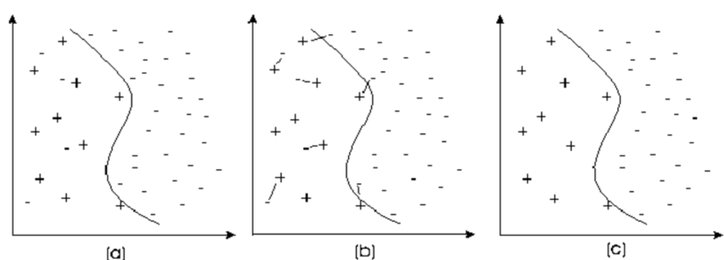
Data Resampling- TOMEK
Tomek removes overlapping links (majority class)
If a (-) is near more (+) and far from (-), then it is removed.
Helps making clear distinctions between classes and removing misclassifications

Slide 28
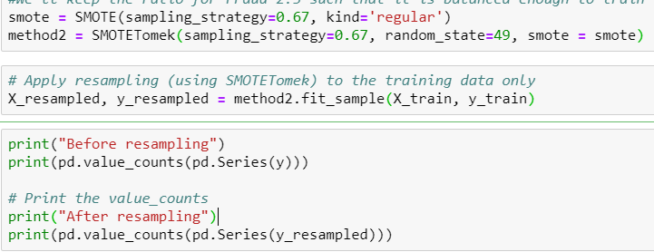
Data Resampling- SMOTE TOMEK Implementation
Perform over-sampling using SMOTE and cleaning using Tomek links.

Slide 29
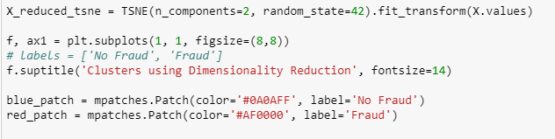
Data Resampling
Evaluating Data Pre-processing
T-distributed Stochastic Neighbour Embedding (T-SNE)
Nonlinear Dimensionality Reduction Technique for Visualization of Clusters
Purpose: To ensure the 2 classes can be separated
Notes:
t-SNE tells us if our prediction model will correctly able to cluster our training set datapoints correctly. From the plot above, we can see that the data can be classified into fraud and non-fraud and thus, we will be moving forward with it N_component = 2 because 2 classes., Random_state=42 so it's easy to re-run and test
SMOTE: it creates synthetic (not duplicate/replicate) samples of the minority class. Hence making the minority class equal to the majority class. SMOTE does this by selecting similar records and altering that record one column at a time by a random amount within the difference to the neighbouring records.

Slide 30
Business Solution
1
Introduction
2
Exploratory Data Analysis
3
Data Pre-Processing
4
Business Solution
5
Model Selection
6
Recommendations
7
Conclusion

Slide 31


Uncertainty in Fraud Detection
Models need to keep up with new emerging types of fraudulent activities
Fraudsters take advantage of fast card transactions and get away with fraud
Most fraud solutions cannot ingest data without expensive and time consuming solutions integration.
These gaps are being violated by fraudsters. Hence, it’s important to take a multi-faceted approach for detecting fraud.
Organisations must use a combination of automated transaction scoring/rules and logic filtering. This is to keep track of real-time transactions, customer authentication, geolocation and/or device verification.
$

Slide 32
The “Cost” Question
Fraud detection and prevention system reduces losses from fraud especially when losses are increasing rapidly. However, it’s very expensive.
In the card industry, while the bank or processor will stop the fraud, cancel the card and send out a new one “in 3 business days,” the resulting inconvenience often erodes customer loyalty. 20% of consumers that experience fraud severed their relationship with their bank or merchant
Problem
Operational cost of controlling fraud (solutions) is too high
The losses, including lost customers due to false positives, could prove significantly more costly over time than solution investments to mitigate such issues in the first place
Solution
An effective fraud mitigation solution should have low false-positive ratios.
Balance between customer satisfaction (by accurate processing of transactions) and minimizing loss due to possible fraudulent transactions (by timely detection)
Notes:
Fraudulent transactions cost companies a lot of money. So we need to ensure that the money is well spent by creating an accurate fraud prediction and prevention system. There are two factors to consider while deciding where the money should be spent

Slide 33
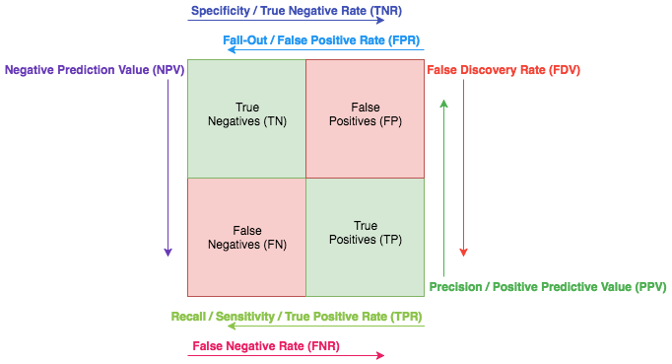
Evaluation Metrics- Confusion Matrix

Slide 34
Evaluation Metrics- Business Impact
Evaluation Metric | Meaning | Business Purpose
Precision | All detected fraud cases are fraud- minimise FP | Focus on retaining customer loyalty, but sacrificing by not detecting some fraud cases
Recall | Find all frauds- maximise TP | Detect as many fraud cases as possible, even if it requires to compromise customer loyalty (falsely accusing some customers)
F1-Score | Equal weightage to Precision and Recall | Give equal emphasis to customer loyalty and detecting fraud cases
Weighted F1-Score | Assigning weights to Precision and Recall | Consider both customer loyalty and detecting fraud cases, but with unequal weightage
ROC AUC | Trade-off between Sensitivity and Specificity- maximise TP | Higher the value, more the number of fraud cases are detected correctly

Slide 35
Evaluation Metrics- Definitions
Precision
Recall
F1- Score
TP
TP + FP
TP
TP + FN
2 P R
P + R
Weighted
F1- Score
Sensitivity
Specificity
2 PR
1.4 P + 0.6 R
TP
TP + FN
TN
TN + FP

Slide 36
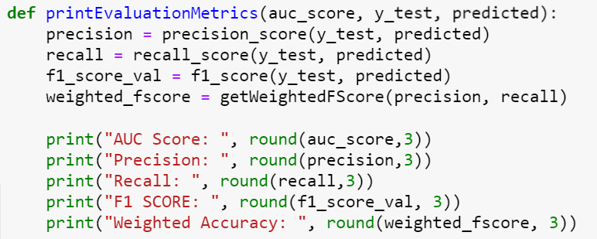
Evaluation Metrics- Implementation
Calculation of Weighted F1- Score:
Print and compare these evaluation metrics for each model

Slide 37
Model Selection
1
Introduction
2
Exploratory Data Analysis
3
Data Pre-Processing
4
Business Solution
5
Model Selection
6
Recommendations
7
Conclusion

Slide 38
Bias-Variance Trade-Off
Bias tends to oversimplify the model and not take all features into consideration
Variance refers to how dependent the model is on the training dataset
High Variance
High Bias
Low Bias Low Variance
Overfitting
Underfitting
Good Balance

Slide 39
Model Selection
Classification Models
Used as Baseline Model.
It’s not used as the final model because it makes 2 assumptions:
Target is linearly dependent on predictors
Predictors have no multicollinearity
Both of these are not true in our case.
Bagging
Algorithms
Logistic Regression
Random Forest
Decision Trees
Boosting Algorithms
Gives us rules for preliminary analysis.
Decision trees are easy to interpret.
However, it’s not used as the final model because:
They are highly unstable (small change in data can lead to a large change in the structure of the original decision tree)
They are highly affected by outliers
AdaBoost

Slide 40

Bagging- Bootstrap Aggregating
Multiple models of same learning algorithm trained with subset of dataset randomly sampled (with replacement) from the training dataset
Randomly select data points into the bags (allow repetitions)
Each bag contains M data points (M<N)
Example: Random Forest Classifier
Training Dataset
(Size N)
Bag 1
Bag 2
Bag 3
Bag 4
Bag 5
Model 1
Model 2
Model 3
Model 4
Model 5
Voting (Majority Wins)

Slide 41
Boosting
Reduces bias by converting multiple weak learning classifiers to one strong learner. Examples: AdaBoost, XGBoost, LGBM, etc.
Randomly select data points into the bags (repetition allow)
Test on validation data on ensemble (Model1 + Model2)
Model 2
Training Dataset
(Size N)
Bag 1
Train
Data Points with Wrong Prediction
Train
Model 1
Repeat
Validation Dataset
Test on Validation data
Bag 2
Place in next bag along with some other data points from training dataset (i.e. wrongly classified data has increase chance of being selected)
Data Points with Wrong Prediction

Slide 42
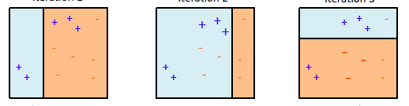
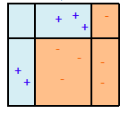
AdaBoost- Adaptive Boosting
AdaBoost is adaptive in the sense that subsequent weak learners are tweaked in favor of those instances misclassified by previous classifiers
Iteration 1
Iteration 2
Iteration 3
Final Classifier/
Strong Classifier

Slide 43
Why is Bagging + Boosting (Random Forest + AdaBoost) better?
Bias
Model with high bias pays little attention to the training data and oversimplifies the model. It always leads to high error on training and test data.
Variance
Model with high variance pays more attention to training data and is not scalable with new data. Hence, they perform very well on training data but have high error rates on test data.
Boosting tries to reduce bias, paying more attention to the training data, especially the harder to classify classes. That may result in overfitting. On the other hand, Bagging simply pick data points randomly, into bag, thus increasing the bias
(i.e., lowering the variance).
Notes:
SVM: not suitable for large datasets because of its high training time

Slide 44
Evaluation Metrics- Comparison of Different Models
Model | Precision | Recall | F1-Score | Weighted F1-Score | AUC Score
Logistic Regression | 0.88 | 0.557 | 0.682 | 0.626 | 0.968
Decision Tree | 0.34 | 0.835 | 0.484 | 0.581 | 0.916
Random Forest | 0.932 | 0.861 | 0.895 | 0.881 | 0.971
Random Forest + AdaBoost | 1 | 0.966 | 0.983 | 0.976 | 0.991

Slide 45
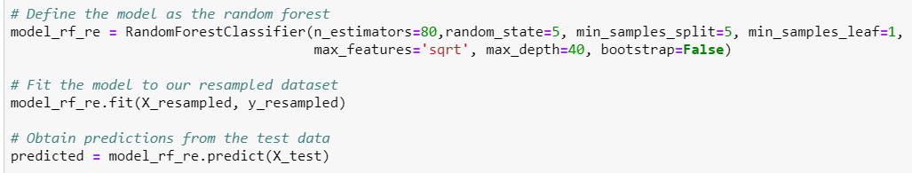
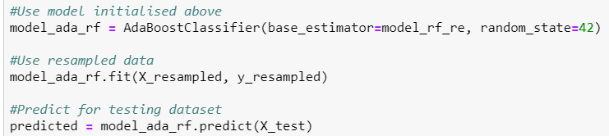
Model Implementation- Random Forest + AdaBoost
Random Forest
AdaBoost

Slide 46
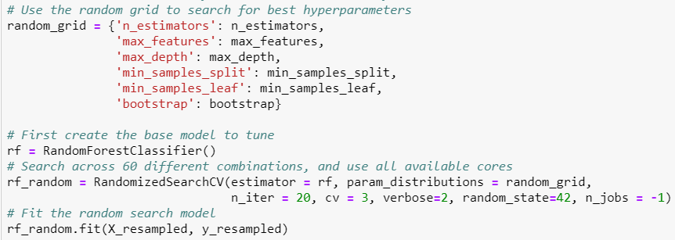
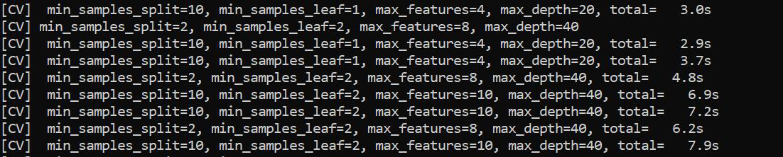
Hyperparameter Tuning- RandomSearchCV

Slide 47
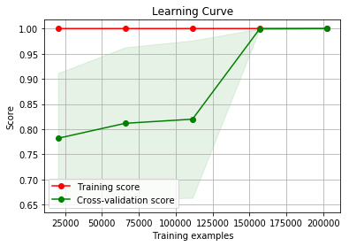
Further Evaluation- Bias- Variance Trade-Off
Learning Curve
For the final model,
bias-variance trade-off is good due to merging of training and cross-validation score
→ robust and good model

Slide 48
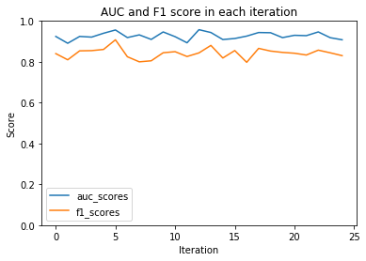
Further Evaluation- K-fold Cross Validation
AUC & F1 Score for each of the 25 Iterations
Minimal fluctuations in F-1 and AUC scores
→ lack of overfitting/ underfitting

Slide 49
Recommendations
1
Introduction
2
Exploratory Data Analysis
3
Data Pre-Processing
4
Business Solution
5
Model Selection
6
Recommendations
7
Conclusion

Slide 50
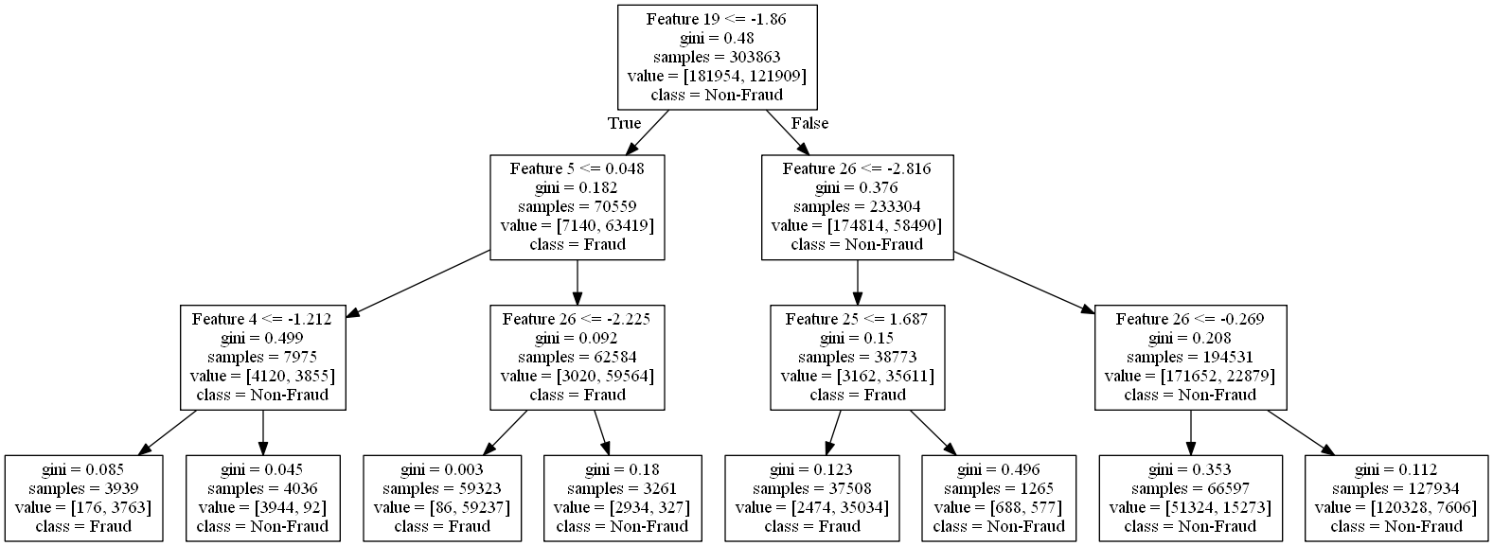
Random Forest – Tree 1
Low value of feature 5: Fraud
Low value of Feature 26: Fraud
Low value of feature 4: Non-Fraud

Slide 51
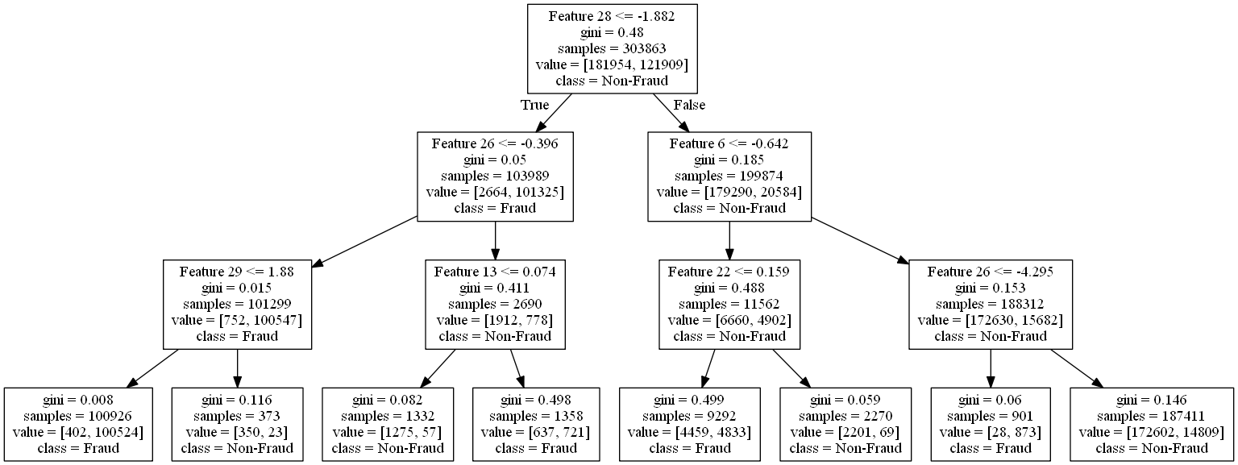
Random Forest – Tree 2
Low value of Feature 28: Non-Fraud
Low value of Feature 26: Fraud

Slide 52
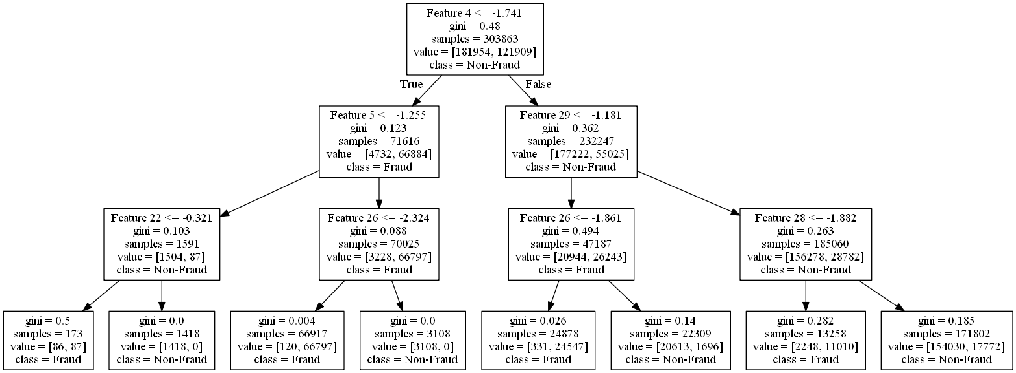
Random Forest – Tree 3
Low value of feature 5: Fraud
Low value of Feature 26: Fraud
Low value of feature 4: Non-Fraud
Low value of feature 28: Non-Fraud

Slide 53
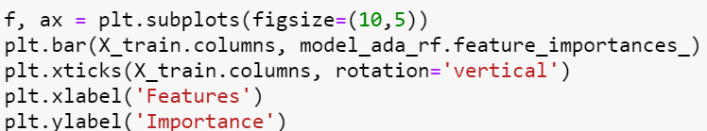
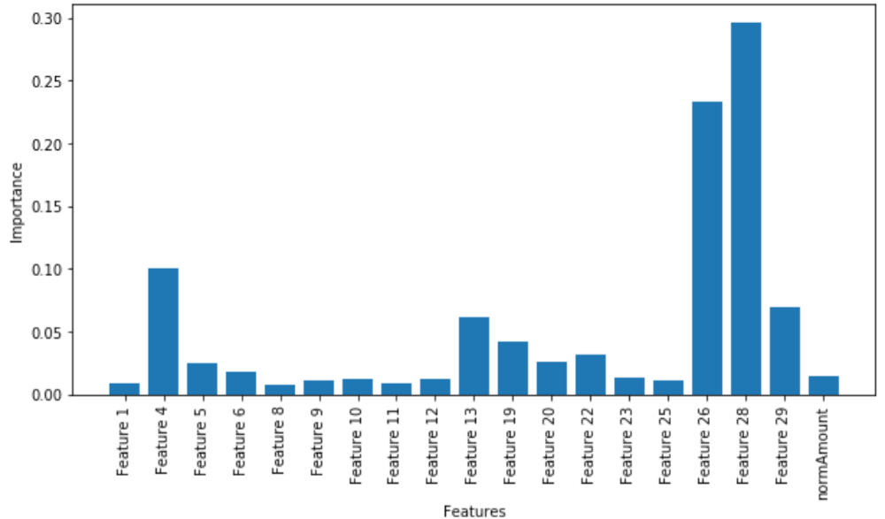
Feature Importance

Slide 54
Decision Making Process
Fraud Category | Corresponding Actions
Fraud | Block and investigate
Moderate Fraud | Investigate and block
Moderate Non-Fraud | Accept and Investigate
Non-Fraud | Accept

Slide 55
Naïve Baes – Decision Making Process
Apply Model on Transactions
Flag as 0
Flag as 1
Feature 4,28 have low value
Feature 5,26 have high value
Yes
No
Yes
No
Non Fraud
Moderate Non-Fraud
Moderate Fraud
Fraud

Slide 56
Business Solution- Model Application
Business Process
Objective Changed
Yes
25Credit Decides Objective
Retrain Model
No
Model Predictions
Achieve Cost Savings
Perform Corresponding Action
Conduct Decision Making Process

Slide 57
Business Solution- Model Application
Model Application
Test Model on Live Scenario
First the model must be put into live server but not affect any decisions to be made.
This will train the model well
Real Time Analysis
Run model in real-time to classify whether transaction is fraudulent or not.
Continuous Training
As more data points are generated, the model will automatically retrain the model and select new important features for fraud classification.
Scalability
Random Forest is able to handle large datasets and is still interpretable

Slide 58
Conclusion
1
Introduction
2
Exploratory Data Analysis
3
Data Pre-Processing
4
Business Solution
5
Model Selection
6
Recommendations
7
Conclusion

Slide 59
Limitations and Constraints
Time Dimensionality
If we had a time dimension in the data (Day/month/year etc) then we could have identified more patterns in terms of when fraudulent transactions occur.
Business Domain Knowledge
Anonymized features without business weightage
Difficult to do feature engineering or assign different weightage to more important features
Data Imputation would be improved with feature understanding
Fraud Categories and Type
If we had categories of transactions then we could have identified further patterns → model will not be able to detect a new fraud type if it occurs unless the model is re-trained

Slide 60
Further Improvements
Automated Feature Engineering
Fraud Probability Model
Increase dimensionality of the dataset and capture more details of the individuals
Important feature selection and engineering automatically updated based on individuals’ profile
Combination of Fraud Regression Probability Model and Fraud Classification Model would enhance model robustness and prediction accuracy
Geospatial Analysis
Apply geospatial analytics to study the location for transactions (real address or IP address) and use spatial analysis to detect any anomaly
Data Points Enhancement
Increase data rows and instances (especially fraudulent transactions) so that the model can be trained better and accuracy can be improved. → large dataset allows building of more robust model (e.g. deep learning models)
User Behaviour Study
Study the user behaviour mouse-clicks, time spent on website, etc as feature as well to predict fraud

Slide 61












Summary
Collect Diverse Data
Pre-process data
Implementation
Decision Choice
User data
Missing values
Detect fraud
Investigate transaction
Transaction
data
Feature Selection
Profile users
Accept/Reject transaction
Client
data
Imbalanced data
Calculate Score
Restrict future transactions

Slide 62
Thank you!

Slide 63
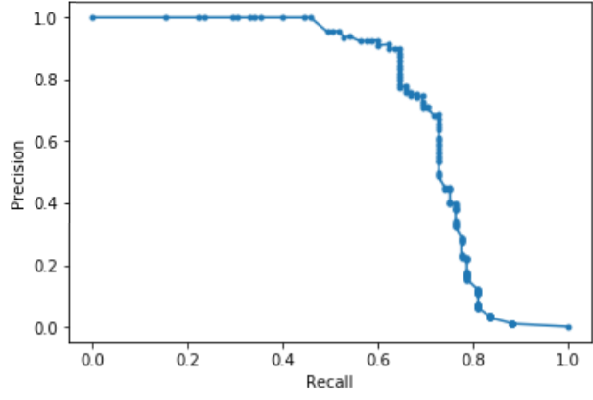
Precision – Recall Curve
Precision-Recall Curve is a good indicator of a model with imbalanced data
A high area under this curve indicates high precision as well as high recall

Slide 64

Evaluation Metrics- Definitions
ROC AUC Score
More frauds found
In ROC curve, true positive rate (Sensitivity) is plotted in function of the false positive rate (100-Specificity) for different cut-off points. A test with perfect discrimination has an ROC curve that passes through the upper left corner (100% sensitivity, 100% specificity).
Therefore the closer the ROC curve is to the upper left corner, the higher the overall accuracy of the test.
True Positive Rate
False Positive Rate

